Slide 1
Planning under Uncertainty with Markov Decision Processes:
Lecture II
Craig Boutilier
Department of Computer Science
University of Toronto

Slide 2
Recap.
We saw logical representations of MDPs
  propositional: DBNs, ADDs, etc.
  first-order: situation calculus
  offer natural, concise representations of MDPs
Briefly discussed abstraction as a general computational technique
  discussed one simple (fixed uniform) abstraction method that gave approximate MDP solution
  construction exploited logical representation

Slide 3
Overview
We’ll look at further abstraction methods based on a decision-theoretic analog of regression
  value iteration as variable elimination
  propositional decision-theoretic regression
  approximate decision-theoretic regression
  first-order decision-theoretic regression
We’ll look at linear approximation techniques
  how to construct linear approximations
  relationship to decomposition techniques
Wrap up

Slide 4
Dimensions of Abstraction (recap.)
^{Uniform}
^{Exact}
^{Adaptive}
^{A B C}
^{A B C}
^{A B C}
^{A B C}
^{5.3}
^{5.3}
^{5.3}
^{5.3}
^{2.9}
^{2.9}
^{A B C}
^{A B C}
^{A B C}
^{A B C}
^{9.3}
^{9.3}
^{Nonuniform}
^{Approximate}
^{Fixed}
^{A}
^{A}
^{A B}
^{5.3}
^{5.2}
^{5.5}
^{5.3}
^{2.9}
^{2.7}
⁼
^{B}
^{A B C}
^{C}
^{9.3}
^{9.0}
^{A B C}

Slide 5
Classical Regression
Goal regression a classical abstraction method
  Regression of a logical condition/formula G through action a is a weakest logical formula C = Regr(G,a) such that: G is guaranteed to be true after doing a if C is true before doing a
  Weakest precondition for G w.r.t. a
C
G
do(a)
¬C
¬G

Slide 6
Example: Regression in SitCalc
For the situation calculus
  Regr(G(do(a,s))): logical condition C(s) under which a leads to G (aggregates C states and ~C states)
Regression in sitcalc straightforward
  Regr(F(x, do(a,s))) ≡ Φ_{F}(x,a,s)
  Regr(¬φ₁) ≡ ¬Regr(φ₁)
  Regr(φ₁∧φ₂) ≡ Regr(φ₁) ∧ Regr(φ₂)
  Regr(∃x.φ₁) ≡ ∃x.Regr(φ₁)

Slide 7
Decision-Theoretic Regression
In MDPs, we don’t have goals, but regions of distinct value.
Decision-theoretic analog: given “logical description” of V^{t+1}, produce such a description of V^{t} or optimal policy (e.g., using ADDs)
Cluster together states at any point in calculation with same best action (policy), or with same value (VF).

Slide 8
Decision-Theoretic Regression
Decision-theoretic complications:
  multiple formulae G describe fixed value partitions
  a can lead to multiple partitions (stochastically)
  so find regions with same “partition” probabilities
G₂
^{p1}
C₁
^{p2}
G₁
G₃
^{p3}
Q^{t}(a)
V^{t-1}

Slide 9
Functional View of DTR
Generally, V^{t-1} depends on only a subset of variables (usually in a structured way).
What is value of action a at time t (at any s)?
RHMt
RHMt+1
f_{Rm}(Rmt,Rmt+1)
V^{t-1}
Mt
Mt+1
f_{M}(Mt,Mt+1)
^{CR}
Tt
Tt+1
f_{T}(Tt,Tt+1)
^{M}
Lt
Lt+1
f_{L}(Lt,Lt+1)
⁻¹⁰
⁰
CRt
CRt+1
f_{Cr}(Lt,Crt,Rct,Crt+1)
RHCt
RHCt+1
f_{Rc}(Rct,Rct+1)

Slide 10
Functional View of DTR
Assume VF V^{t-1} is structured: what is value of doing action a (DelC) at time t ?
Qªt(Rmt,Mt,Tt,Lt,Crt,Rct)
= R + Σ_{Rm,M,T,L,Cr,Rc(t+1)} Prª(Rmt-1,Mt-1,Tt-1,Lt-1,Crt-1,Rct-1 | Rmt,Mt,Tt,Lt,Crt,Rct) *
Vt-1(Rmt-1,Mt-1,Tt-1,Lt-1,Crt+1,Rct-1)
= R + Σ_{Rm,M,T,L,Cr,Rc(t+1)} f_{Rm}(Rmt,Rmt-1) f_{M}(Mt,Mt-1) f_{T}(Tt,Tt-1) f_{L}(Lt,Lt-1) f_{Cr}(Lt,Crt,Rct,Crt-1)
f_{Rc}(Rct,Rct-1) Vt-1(Mt-1,Crt-1)
= R + Σ_{M,Cr,Rc(t+1)} f_{M}(Mt,Mt-1) f_{Cr}(Lt,Crt,Rct,Crt-1) Vt-1(Mt-1,Crt-1)
= f(Mt,Lt,Crt,Rct)

Slide 11
Functional View of DTR
Q^{t}(a) depends only on a subset of variables
  the relevant variables determined automatically by considering variables mentioned in V^{t-1} and their parents in DBN for action a
  Q-functions can be produced directly using VE
Notice also that these functions may be quite compact (e.g., if VF and CPTs use ADDs)
  we’ll see this again

Slide 12
Planning by DTR
Standard DP algorithms can be implemented using structured DTR
All operations exploit ADD rep’n and algorithms
  multiplication, summation, maximization of functions
  standard ADD packages very fast
Several variants possible
  MPI/VI with decision trees [BouDeaGol95,00; Bou97; BouDearden96]
  MPI/VI with ADDs [HoeyStAubinHuBoutilier99, 00]

Slide 13
Structured Value Iteration
Assume compact representation of V^{k}
  start with R at stage-to-go 0 (say)
For each action a, compute Q^{k+1} using variable elimination on the two-slice DBN
  eliminate all k-variables, leaving only k+1 variables
  use ADD operations if initial rep’n allows
Compute V^{k+1} = max_{a} Q^{k+1}
  use ADD operations if initial representation allows
Policy iteration can be approached similarly.

Slide 14
Structured Policy and Value Function
^{HCU}
^{HCU}
^{W}
^{HCR}
^{Noop}
^{HCR}
^{Loc}
^{Loc}
^{9.00}
^{10.00}
^{Loc}
^{Loc}
^{DelC}
^{W}
^{BuyC}
^{W}
^{W}
^{W}
^{W}
^{R}
^{7.45}
^{R}
^{6.64}
^{R}
^{5.19}
^{R}
^{5.83}
^{R}
^{U}
^{U}
^{U}
^{U}
^{U}
^{Go}
^{GetU}
^{8.45}
^{8.36}
^{7.64}
^{6.81}
^{6.19}
^{5.62}
^{6.83}
^{6.10}

Slide 15
Structured Policy Evaluation: Trees
Assume a tree for V ^{t}, produce V ^{t+1}
For each distinction Y in Tree(V ^{t} ):
  a) use 2TBN to discover conditions affecting Y
  b) piece together using the structure of Tree(V ^{t} )
Result is a tree exactly representing V ^{t+1}
  dictates conditions under which leaves (values) of Tree(V ^{t} ) are reached with fixed probability

Slide 16
A Simple Action/Reward Example
^{X}
X
X
^{1.0}
^{0.0}
^{X}
Z
Y
Y
^{0.9}
^{Y}
^{1.0}
^{0.0}
10
0
^{Y}
Z
Z
^{0.9}
^{Z}
^{1.0}
^{0.0}
^{Network Rep’n for Action A}
^{Reward Function R}

Slide 17
Example: Generation of V¹
^{Z}
^{Y}
^{Y}
^{Y}
¹⁰
⁰
^{Z: 0.9}
^{Z}
^{9.0}
^{Z}
^{8.1}
^{Z}
^{Z: 1.0}
^{Z: 0.0}
^{10.0}
^{0.0}
^{19.0}
^{0.0}
^{V0 = R}
^{Step 1}
^{Step 2}
^{Step 3: V1}

Slide 18
Example: Generation of V²
^{Y}
^{X}
^{X}
^{8.1}
^{Z}
^{Y: 0.9}
^{Y}
^{19.0}
^{0.0}
^{Y: 1.0}
^{Y: 0.0}
^{Y}
^{Y}
^{Y: 0.9}
^{Z: 0.9}
^{Z}
^{Y: 1.0}
^{Z}
^{Y:0.9}
^{Z: 1.0}
^{Y: 0.9}
^{Z: 0.0}
^{Y:0.0}
^{Z: 1.0}
^{Y: 0.0}
^{Z: 0.0}
^{V1}
^{Step 1}
^{Step 2}

Slide 19
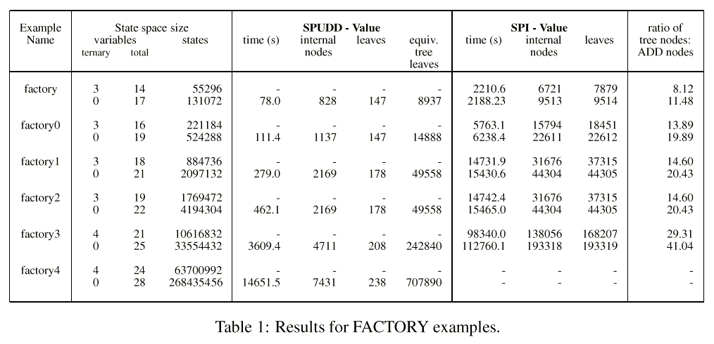
Some Results: Natural Examples

Slide 20
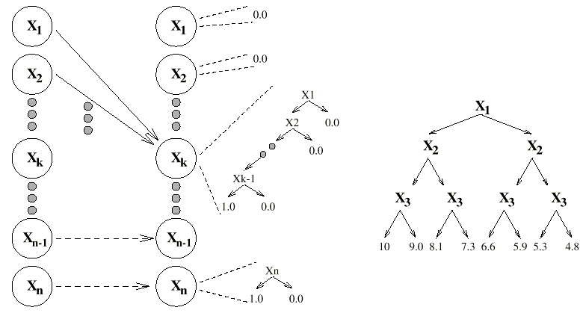
A Bad Example for SPUDD/SPI
Reward: 10 if all
X₁ ... X_{n} true
(Value function for
n = 3 is shown)
Action a_{k} makes X_{k} true;
makes X₁... X_{k-1} false;
requires X₁... X_{k-1} true

Slide 21
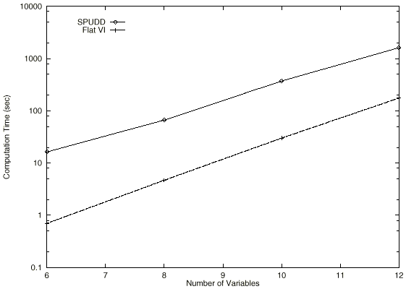
Some Results: Worst-case

Slide 22
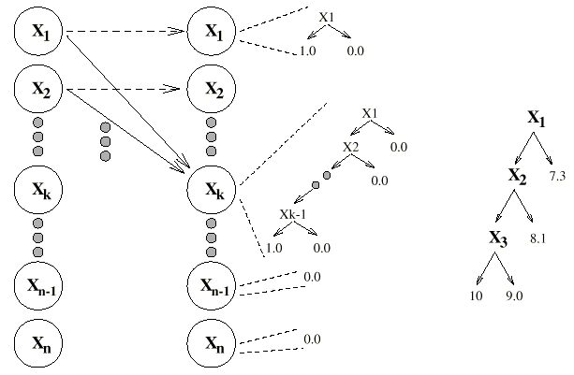
A Good Example for SPUDD/SPI
Reward: 10 if all
X₁ ... X_{n} true
(Value function for
n = 3 is shown)
Action a_{k} makes X_{k} true;
requires X₁... X_{k-1} true

Slide 23
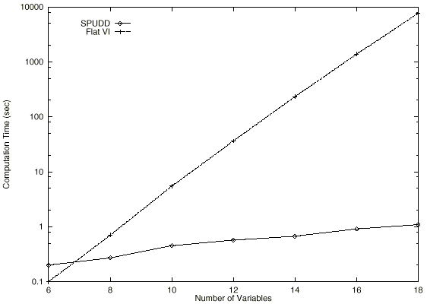
Some Results: Best-case

Slide 24
DTR: Relative Merits
Adaptive, nonuniform, exact abstraction method
  provides exact solution to MDP
  much more efficient on certain problems (time/space)
  400 million state problems (ADDs) in a couple hrs
Some drawbacks
  produces piecewise constant VF
  some problems admit no compact solution representation (though ADD overhead “minimal”)
  approximation may be desirable or necessary

Slide 25
Approximate DTR
Easy to approximate solution using DTR
Simple pruning of value function
  Can prune trees [BouDearden96] or ADDs [StaubinHoeyBou00]
Gives regions of approximately same value

Slide 26
A Pruned Value ADD
^{HCU}
^{HCU}
^{W}
^{HCR}
^{[9.00, 10.00]}
^{HCR}
^{9.00}
^{10.00}
^{Loc}
^{W}
^{Loc}
^{[5.19, 6.19]}
^{W}
^{W}
^{5.19}
^{R}
^{[7.45,} ^{8.45]}
^{[6.64, 7.64]}
^{7.45}
^{R}
^{6.64}
^{R}
^{U}
^{U}
^{U}
^{6.19}
^{5.62}
^{8.45}
^{8.36}
^{7.64}
^{6.81}

Slide 27
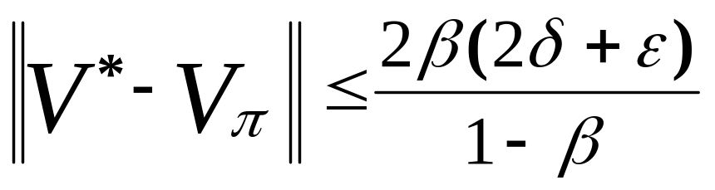
Approximate Structured VI
Run normal SVI using ADDs/DTs
  at each leaf, record range of values
At each stage, prune interior nodes whose leaves all have values with some threshold δ
  tolerance can be chosen to minimize error or size
  tolerance can be adjusted to magnitude of VF
Convergence requires some care.
If max. span over leaves < δ and term. tol. < ε:

Slide 28
Approximate DTR: Relative Merits
Relative merits of ADTR
  fewer regions implies faster computation
  can provide leverage for optimal computation
  30-40 billion state problems in a couple hours
  allows fine-grained control of time vs. solution quality with dynamic (a posteriori) error bounds
  technical challenges: variable ordering, convergence, fixed vs. adaptive tolerance, etc.
Some drawbacks
  (still) produces piecewise constant VF
  doesn’t exploit additive structure of VF at all

Slide 29
First-order DT Regression
DTR methods so far are propositional
  extension to FO case critical for practical planning
First-order DTR extends existing propositional DTR methods in interesting ways.
First let’s quickly recap. the stochastic sitcalc specification of MDPs

Slide 30
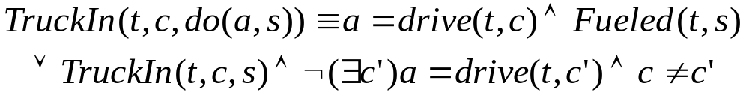
SitCal: Domain Model (Recap.)
Domain axiomatization: successor state axioms
  one axiom per fluent F: F(x, do(a,s)) ≡ Φ_{F}(x,a,s)
These can be compiled from effect axioms
  use Reiter’s domain closure assumption

Slide 31
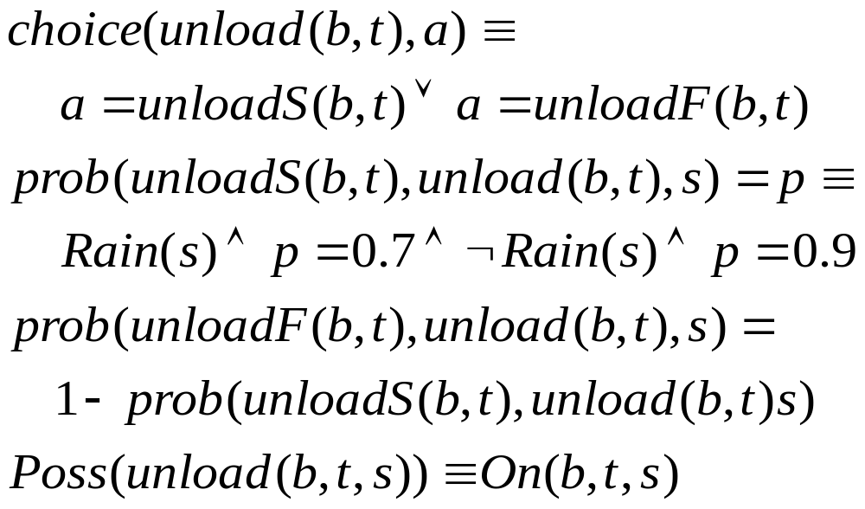
Axiomatizing Causal Laws (Recap.)

Slide 32
Stochastic Action Axioms (Recap.)
For each possible outcome o of stochastic action a(x), n_{o}(x) let denote a deterministic action
Specify usual effect axioms for each n_{o}(x)
  these are deterministic, dictating precise outcome
For a(x), assert choice axiom
  states that the n_{o}(x) are only choices allowed by nature
Assert prob. axioms
  specifies prob. with which n_{o}(x) occurs in situation s
  can depend on properties of situation s
  must be well-formed (probs over the different outcomes sum to one in each feasible situation)

Slide 33
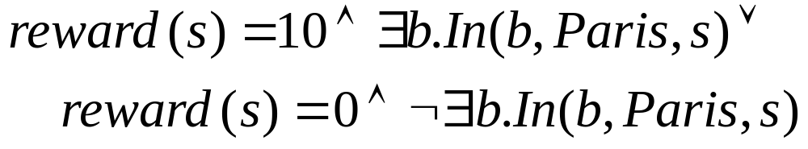
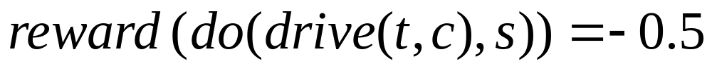
Specifying Objectives (Recap.)
Specify action and state rewards/costs

Slide 34
First-Order DT Regression: Input
Input: Value function V^{t}(s) described logically:
  If φ₁ : v₁ ; If φ₂ : v₂ ; ... If φ_{k} : v_{k}
Input: action a(x) with outcomes n₁(x),...,n_{m}(x)
  successor state axioms for each n_{i} (x)
  probabilities vary with conditions: μ₁ , ..., μ_{n}
∃t.On(B,t,s) : 10
¬∃t.On(B,t,s) : 0
Rain ¬Rain
0.7 0.9
0.3 0.1
loadS(b,t) : On(b,t)
load(b,t)
loadF(b,t) : -----

Slide 35
First-Order DT Regression: Output
Output: Q-function Q^{t+1}(a(x),s)
  also described logically: If θ₁ : q₁ ; ... If θ_{k} : q_{k}
This describes Q-value for all states and for all instantiations of action a(x)
  state and action abstraction
We can construct this by taking advantage of the fact that nature’s actions are deterministic.

Slide 36
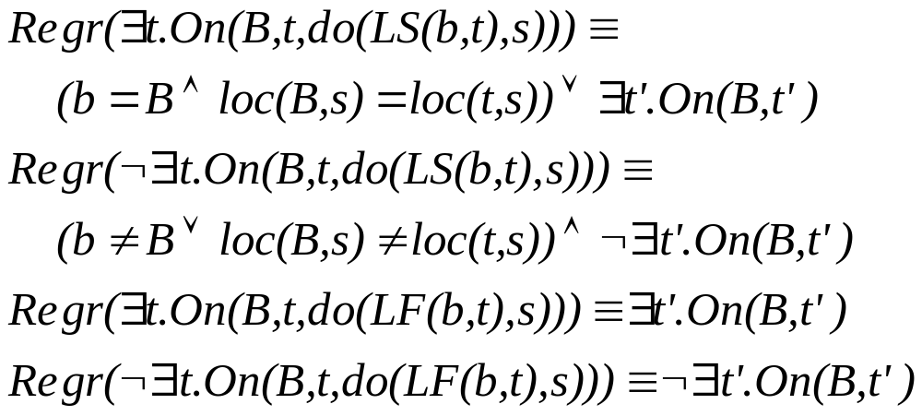
Step 1
Regress each φ_{i}-n_{j} pair: Regr(φ_{i},do(n_{j}(x),s))
A.
B.
C.
D.

Slide 37
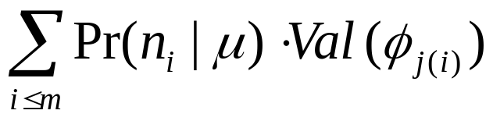
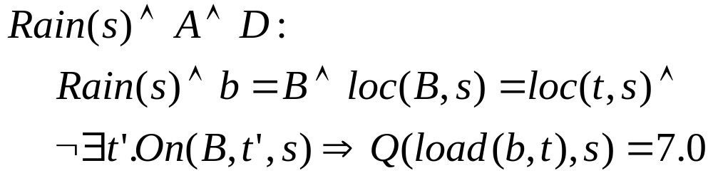
Step 2
Compute new partitions:
  θ_{k} = μ_{i} ∧ Regr(φ_{j(1)},n₁) ∧ ... ∧ Regr(φ_{j(m)},n_{m})
  Q-value is:
D: LoadF, pr =0.3,val=0
A: LoadS, pr =0.7,val=10

Slide 38
Step 2: Graphical View
∃t.On(B,t,s)
1.0
∃t.On(B,t,s) : 10
10
¬∃t.On(B,t,s) & Rain(s)
& b=B & loc(b,s)=loc(t,s)
0.7
0.3
7
0.9
¬∃t.On(B,t,s) & ¬Rain(s)
& b=B & loc(b,s)=loc(t,s)
¬∃t.On(B,t,s) : 0
0.1
9
(¬b=B v ¬loc(b,s)=loc(t,s))
& ¬∃t.On(B,t,s)
1.0
0

Slide 39
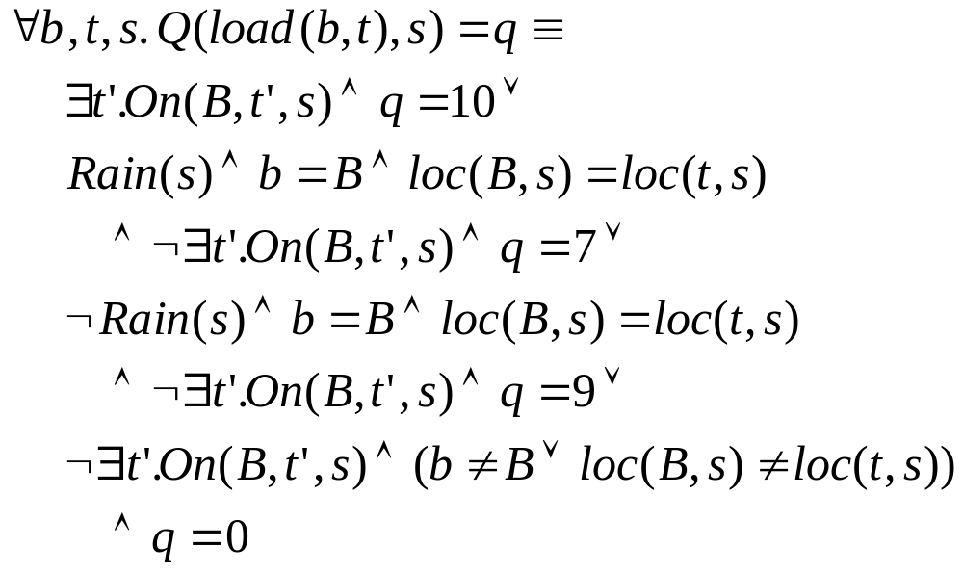
Step 2: With Logical Simplification

Slide 40
DP with DT Regression
Can compute V^{t+1}(s) = max_{a} {Q^{t+1}(a,s)}
Note:Q^{t+1}(a(x),s) may mention action properties
  may distinguish different instantiations of a
Trick: intra-action and inter-action maximization
  Intra-action: max. over instantiations of a(x) to remove dependence on action variables x
  Inter-action: max. over different action schemata to obtain value function

Slide 41
Intra-action Maximization
Sort partitions of Q^{t+1}(a(x),s) in order of value
  existentially quantify over x in each to get Q_{a}^{t+1}(s)
  conjoin with negation of higher valued partitions
E.g., suppose Q(a(x),s) has partitions:
  p(x,s) ∧ φ₁(s) : 10 ¬p(x,s) ∧ φ₂(s) : 8
  p(x,s) ∧ φ₃(s) : 6 ¬p(x,s) ∧ φ₄(s) : 4
Then we have the “pure state” Q-function:
  ∃x. p(x,s)∧ φ₁(s) : 10
  ∃x.¬p(x,s)∧ φ₂(s) ∧ ¬∃x.p(x,s) ∧ φ₁(s) : 8
  ∃x. p(x,s)∧ φ₃(s) ∧ ¬∃x.[p(x,s)∧ φ₁(s) ∨¬p(x,s)∧ φ₂(s)]: 6
  …

Slide 42
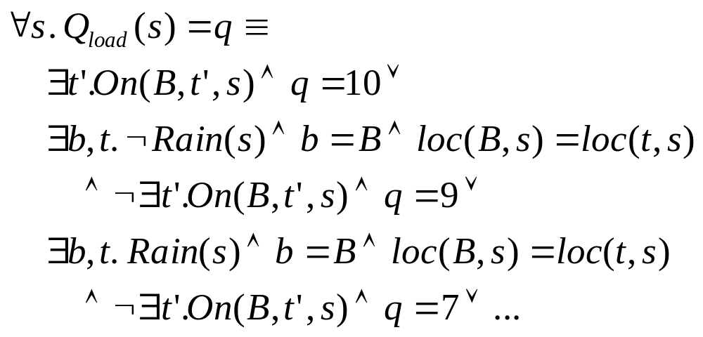
Intra-action Maximization Example

Slide 43
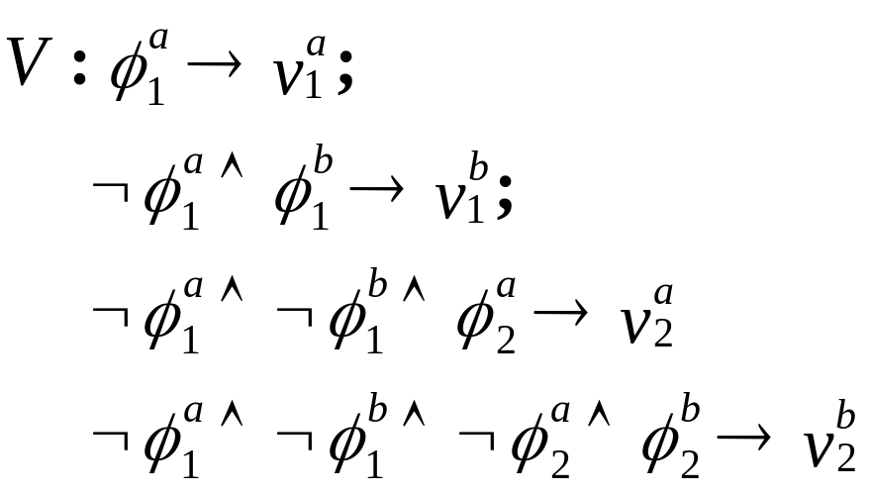
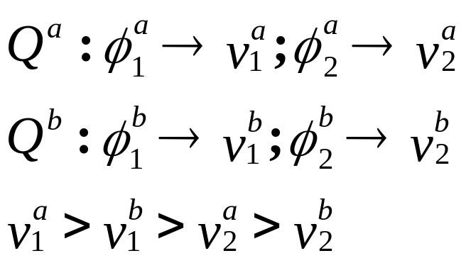
Inter-action Maximization
Each action type has “pure state” Q-function
Value function computed by sorting partitions and conjoining formulae

Slide 44
FODTR: Summary
Assume logical rep’n of value function V^{t}(s)
  e.g., V⁰(s) = R(s) grounds the process
Build logical rep’n of Q^{t+1}(a(x),s) for each a(x)
  standard regression on nature’s actions
  combine using probabilities of nature’s choices
  add reward function, discounting if necessary
Compute Q_{a}^{t+1}(s) by intra-action maximization
Compute V^{t+1}(s) = max_{a} {Q_{a}^{t+1}(s)}
Iterate until convergence

Slide 45
FODTR: Implementation
Implementation does not make procedural distinctions described
  written in terms of logical rewrite rules that exploit logical equivalences: regression to move back states, definition of Q-function, definition of value function
  (incomplete) logical simplification achieved using theorem prover (LeanTAP)
Empirical results are fairly preliminary, but gradient is encouraging.

Slide 46
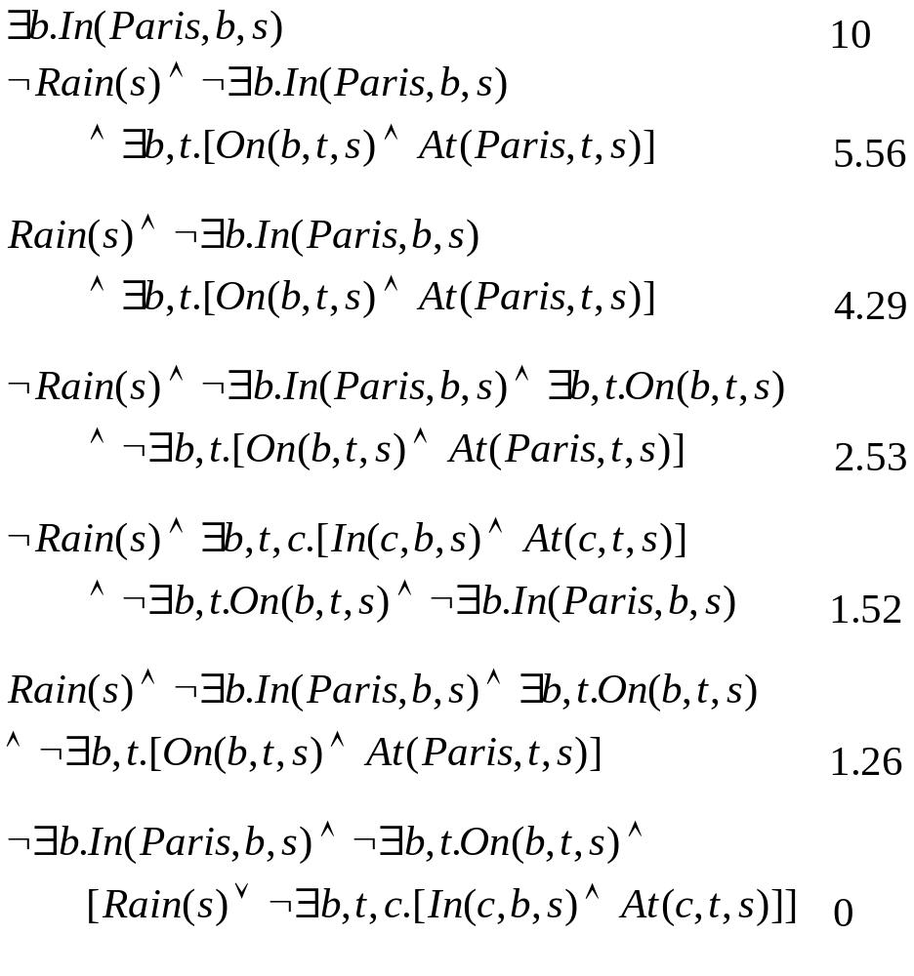
Example Optimal Value Function

Slide 47
Benefits of F.O. Regression
Allows standard DP to be applied in large MDPs
  abstracts state space (no state enumeration)
  abstracts action space (no action enumeration)
DT Regression fruitful in propositional MDPs
  we’ve seen this in SPUDD/SPI
  leverage for: approximate abstraction; decomposition
We’re hopeful that FODTR will exhibit the same gains and more.
Possible use in DTGolog programming paradigm

Slide 48
Function Approximation
Common approach to solving MDPs
  find a functional form f(θ) for VF that is tractable
    e.g., not exponential in number of variables
  attempt to find parameters θ s.t. f(θ) offers “best fit” to “true” VF
Example:
  use neural net to approximate VF
    inputs: state features; output: value or Q-value
  generate samples of “true VF” to train NN
    e.g., use dynamics to sample transitions and train on Bellman backups (bootstrap on current approximation given by NN)

Slide 49
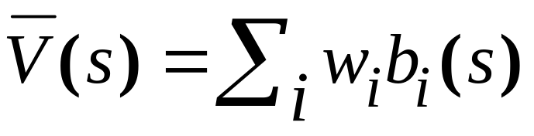
Linear Function Approximation
Assume a set of basis functions B = { b₁ ... b_{k} }
  each b_{i} : S → ℜ generally compactly representable
A linear approximator is a linear combination of these basis functions; for some weight vector w:
Several questions:
  what is best weight vector w?
  what is a “good” basis set B?
  what does this buy us computationally?

Slide 50
Flexibility of Linear Decomposition
Assume each basis function is compact
  e.g., refers only a few vars; b₁(X,Y), b₂(W,Z), b₃(A)
Then VF is compact:
  V(X,Y,W,Z,A) = w₁ b₁(X,Y) + w₂ b₂(W,Z) + w₃ b₃(A)
For given representation size (10 parameters), we get more value flexibility (32 distinct values) compared to a piecewise constant rep’n.
So if we can find decent basis sets (that allow a good fit), this can be more compact.

Slide 51
Linear Approx.: Components
Assume basis set B = { b₁ ... b_{k} }
  each b_{i} : S → ℜ
  we view each b_{i} as an n-vector
  let A be the n x k matrix [ b₁ ... b_{k} ]
Linear VF: V(s) = Σ w_{i} b_{i}(s)
Equivalently: V = Aw
  so our approximation of V must lie in subspace spanned by B
  let B be that subspace

Slide 52
Approximate Value Iteration
We might compute approximate V using ValuIter:
  Let V⁰ = Aw⁰ for some weight vector w⁰
  Perform Bellman backups to produce V¹ = Aw¹; V² = Aw²; V³ = Aw³; etc.
Unfortunately, even if V⁰ in subspace spanned by B, L*(V⁰) = L*(Aw⁰) will generally not be
So we need to find best approximation to L*(Aw⁰) in B before we can proceed

Slide 53
Projection
We wish to find a projection of our VF estimates into B minimizing some error criterion
  We’ll use max norm (standard in MDPs)
Given V lying outside B, we want a w s.t:
|| Aw – V || is minimal

Slide 54
Projection as Linear Program
Finding a w that minimizes || Aw – V || can be accomplished with a simple LP
Number of variables is small (k+1); but number of constraints is large (2 per state)
  this defeats the purpose of function approximation
  but let’s ignore for the moment
Vars: w₁, ..., w_{k}, φ
Minimize: φ
S.T. φ ≥ V(s) – Aw(s) , ∀s
φ ≥ Aw(s) - V(s) , ∀s
φ measures max norm difference between V and “best fit”

Slide 55
Approximate Value Iteration
Run value iteration; but after each Bellman backup, project result back into subspace B
Choose arbitrary w⁰ and let V⁰ = Aw⁰
Then iterate
  Compute V^{t} =L*(Aw^{t-1})
  Let V^{t =} Aw^{t} be projection of V^{t} into B
Error at each step given by φ
  final error, convergence not assured
Analog for policy iteration as well

Slide 56
Factored MDPs
Suppose our MDP is represented using DBNs and our reward function is compact
  can we exploit this structure to implement approximate value iteration more effectively?
We’ll see that if our basis functions are “compact”, we can implement AVI without state enumeration (GKP-01)
  we’ll exploit principles we’ve seen in abstraction methods

Slide 57
Assumptions
State space defined by variables X₁ , ... , X_{n}
DBN action representation for each action a
  assume small set Par(X’_{i})
Reward is sum of components
  R(X) = R₁(W₁) + R₂(W₂) + ...
  each W_{i} ⊂ X is a small subset
Each basis function b_{i} refers to a small subset of vars C_{i}
  b_{i}(X) = b_{i}(C_{i})
X₁
X’₁
X₂
X’₂
X₃
X’₃
R(X₁X₂X₃)
= R₁(X₁X₂) + R₂(X₃)

Slide 58
Factored AVI
AVI: repeatedly do Bellman backups, projections
With factored MDP and basis representations
  Aw and V are functions of variables X₁ , ... , X_{n}
  Aw is compactly representable
    Aw = w₁b₁(C₁) + ... + w_{k}b_{k}(C_{k})
    each C_{i} ⊂ X is a small subset
  So V^{t =} Aw^{t} (projection of V^{t} into B ) is compact
So we need to ensure that:
  each V^{t} (nonprojected Bellman backup) is compact
  we can perform projection effectively

Slide 59
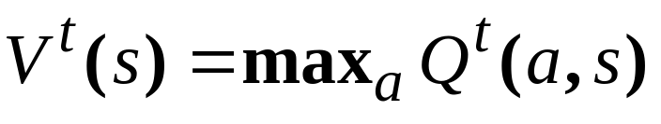
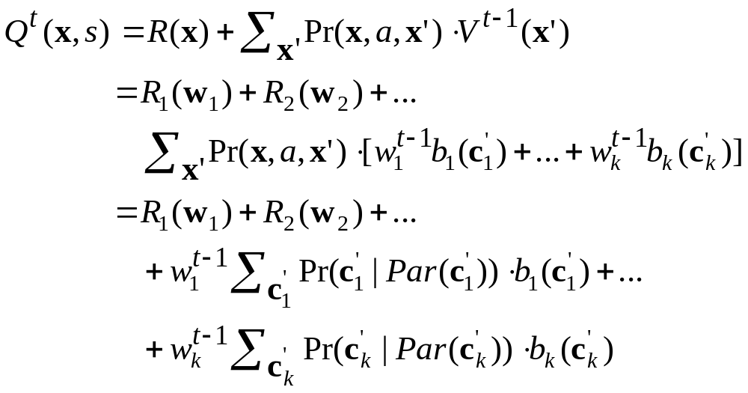
Compactness of Bellman Backup
Bellman backup:
Q-function:

Slide 60
Compactness of Bellman Backup
So Q-functions are (weighted) sums of a small set of compact functions:
  the rewards R_{i}(W_{i})
  the functions f_{i}(Par(C_{i})) – each of which can be computed effectively (sum out only vars in C_{i} )
  note: backup of each b_{i} is decision-theoretic regression
Maximizing over these to get VF straightforward
  Thus we obtain compact rep’n of V^{t} =L*(Aw^{t-1})
Problem: these new functions don’t belong to the set of basis functions
  need to project V^{t} into B to obtain V^{t}

Slide 61
Factored Projection
We have V^{t} and want to find weights w^{t} that minimize ||Aw^{t} – V^{t} ||
  We know V^{t} is the sum of compact functions
  We know Aw^{t} is the sum of compact functions
  Thus, their difference is the sum of compact functions
So we wish to minimize || Σ f_{j}(Z_{j} ; w^{t}) ||
  each f_{j} depends on small set of vars Z_{j} and possibly some of the weights w^{t}
Assume weights w^{t} are fixed for now
  then || Σ f_{j}(Z_{j} ; w^{t}) || = max { Σ f_{j}(z_{j} ; w^{t}) : x∈X}

Slide 62
Variable Elimination
Max. of sum of compact functions: variable elim.
Complexity determined by size of intermediate factors (and elim. ordering)
max X₁X₂X₃X₄X₅X₆ { f₁(X₁X₂X₃) + f₂(X₃X₄) + f₃(X₄X₅X₆) }
Elim X₁: Replace f₁(X₁X₂X₃) with
f₄(X₂X₃) = max X₁ { f₁(X₁X₂X₃) }
Elim X₃: Replace f₂(X₃X₄) and f₄(X₂X₃) with
f₅(X₂X₄) = max X₃ { f₁(X₁X₂X₃) + f₄(X₂X₃) }
etc. (eliminating each variable in turn until maximum value
is computed over entire state space)

Slide 63
Factored Projection: Factored LP
VE works for fixed weights
  but w^{t} is what we want to optimize
  Recall LP for optimizing weights:
φ ≥ V(s) – Aw(s) , ∀s
  equiv. to φ ≥ max {V(s) – Aw(s) , s∈S}
  equiv. to φ ≥ max {Σ f_{j}(z_{j} ; w) , x∈X}
Vars: w₁, ..., w_{k}, φ
Minimize: φ
S.T. φ ≥ V(s) – Aw(s) , ∀s
φ ≥ Aw(s) - V(s) , ∀s

Slide 64
Factored Projection: Factored LP
The constraints: φ ≥ max {Σ f_{j}(z_{j} ; w) , x∈X}
  exponentially many
  but we can “simulate” VE to reduce the expression of these constraints in the LP
  the number of constraints (and new variables) will be bounded by the “complexity of VE”

Slide 65
Factored Projection: Factored LP
Choose an elimination ordering for computing max {Σ f_{j}(z_{j} ; w) , x∈X}
  note: weight vector w is unknown
  but structure of VE remains the same (actual numbers can’t be computed)
For each factor (initial and intermediate) e(Z)
  create a new variable u(e,z₁,...,z_{n}) for each instantiation z₁,...,z_{n} of the domain Z
  number of new variables exponential in size (#vars) of factor

Slide 66
Factored Projection: Factored LP
For each initial factor f_{j}(Z_{j} ; w), pose constraint:
  though the w are vars, f_{j}(Z_{j} ; w) linear in w
u(f_{j},z₁,...,z_{n}) = f_{j}(z₁,...,z_{n};w) , ∀z₁,...,z_{n}

Slide 67
Factored Projection: Factored LP
For elim. step where X_{k} removed, let
  g_{k}(Z_{k}) = max_{Xk} g_{k1}(Z_{k1}) + g_{k2}(Z_{k2}) + ...
  here each g_{kj} a factor including X_{k} (and is removed)
For each intrm factor g_{k}(Z_{k}) , pose constraint:
  force u-values for each factor to be at least max. over X_{k} values
  number of constraints: size of factor * |X_{k}|
u(g_{k},z₁,...,z_{n}) ≥
g_{k1}(z₁,...,z_{n1}) + g_{k1}(z₁,...,z_{n1})+..., ∀x_{k},∀z₁,...,z_{n}

Slide 68
Factored Projection: Factored LP
Finally pose constraint
This ensures:
Note: objective function in LP minimizes φ
  so constraints are satisfied at the max. values
In this way
  we optimize weights at each iteration of ValIter
  but we never enumerate the state space
  size of LPs bounded by total factor size in VE
φ ≥ u_{final}()
φ ≥ max {Σ f_{j}(z_{j} ; w) , x∈X} = max {V(s) – Aw(s) , s∈S}

Slide 69
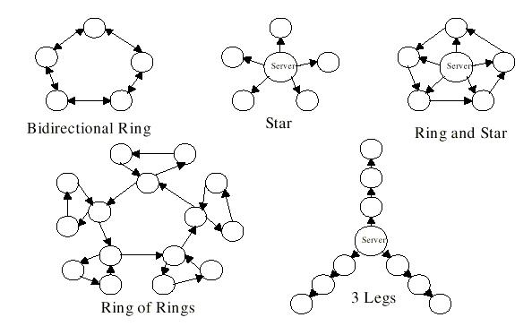
Some Results [GKP-01]
Basis sets considered:
  characteristic functions over single variables
  characteristic functions over pairs of variables

Slide 70
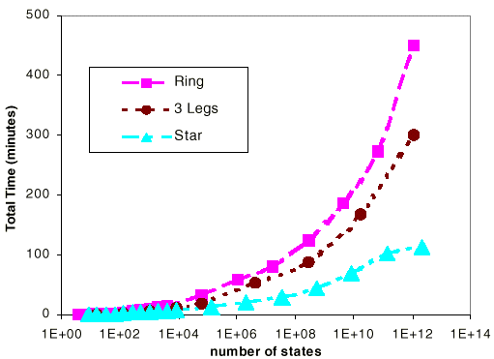
Some Results [GKP-01]
Computation Time

Slide 71
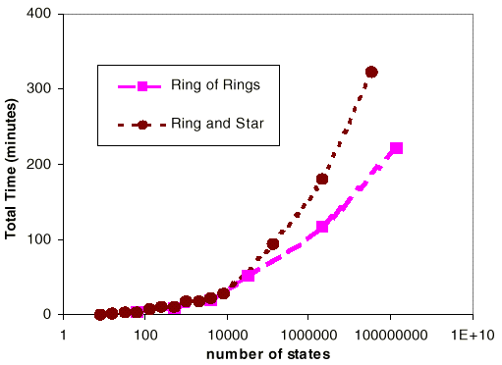
Some Results [GKP-01]
Computation Time

Slide 72
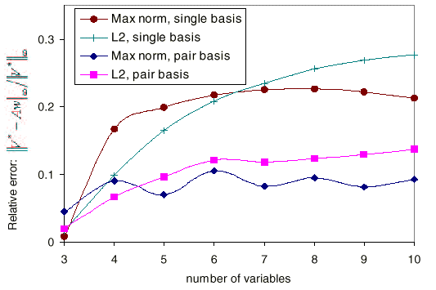
Some Results [GKP-01]
Relative error w.r.t. optimal VF (small problems)

Slide 73
Linear Approximation: Summary
Results seem encouraging
  40 variable problems solved in a few hours
  simple basis sets seem to work well for “network” problems
Open issues:
  are tighter (a priori) error bounds possible?
  better computational performance?
  where do basis functions come from?
    what impact can good/poor basis set have on solution quality?
  are there “nonlinear” generalizations?

Slide 74
An LP Formulation
AVI requires generating a large number of constraints (and solving multiple LPs/cost nets)
But normal MDP can be solved by an LP directly:
  (LªV)(s) is linear in values/vars V(s)
Vars: V(s)
Minimize: Σ_{s} V(s)
S.T. V(s) ≥ (LªV)(s) , ∀a,s

Slide 75
Using Structure in LP Formulation
These constraints can be formulated without enumerating state space using cost network as before [SchPat-00]
  by not iterating, great computational savings possible
    a couple orders of magnitude on “networks”
  techniques like constraint generation offer even more substantial savings

Slide 76
Good Basis Sets
A good basis set should
  be reasonably small and well-factored
  be such that a good approximation to V* lies in the subspace B
Latter condition hard to guarantee
Possible ways to construct basis sets
  use prior knowledge of domain structure
    e.g., problem decomposition
  search over candidate basis sets
    e.g., sol’n using a poor approximation might guide search for an improved basis

Slide 77
Parallel Problem Decomposition
Decompose MDP into parallel processes
  product/join decomp.
  each refers to subset of relevant variables
  actions affect each
Key issues:
  how to decompose?
  how to merge sol’ns?
Contrast serial decomposition
  macros [Sutton95,Parr98]
^{MDP1}
^{MDP2}
^{MDP3}
Notes:
Mention: this is quite different from abstraction. We are not aggregrating states, we are “decomposing” states along various lines.

Slide 78
Generating SubMDPs
Components of additive reward: subobjectives
  often combinatorics due to many competing objectives
  e.g., logistics, process planning, order scheduling
  [BouBrafmanGeib97, SinghCohn97, MHKPKDB98]
Create subMDPs for subobjectives
  use abstraction methods discussed earlier to find subMDP relevant to each subobjective
  solve using standard methods, DTR, etc.

Slide 79
Generating SubMDPs
Dynamic Bayes Net over Variable Set

Slide 80
Generating SubMDPs
Green SubMDP (subset of variables)

Slide 81
Generating SubMDPs
Red SubMDP (subset of variables)

Slide 82
Composing Solutions
Existing methods piece together solutions in an online fashion; for example:
  1. Search-based composition [BouBrafmanGeib97]: VFs used in heuristic search
    partial ordering of actions used to merge
  2. Markov Task Decomposition [MHKPKDB98]:
    has ability to deal with large actions spaces
    MDPs with thousands of variables solvable

Slide 83
Search-based Composition
s1
Online action selection: standard expectimax search [DB94,97,BBS95,KS95,BG98,KMN99,...]
Max
a1
a2
p2
p2
p3
p4
Exp
Exp
s2
s3
s4
s5
a1
a2
a1
a2
Notes:
Don’t discuss details of tree: just use it as a graphical device. If people don’t quite get it, don’t worry.

Slide 84
Search-based Composition
s1
Online action selection: standard expectimax search [DB94,97,BBS95,KS95,BG98,KMN99,...]
Decomposed VFs viewed as heuristics (reduce requisite search depth for given error)
E.g., given subVFs f₁,...f_{k}
Max
a1
a2
p2
p2
p3
p4
Exp
Exp
s2
s3
s4
s5
a1
a2
a1
a2
V(s) <= f₁(s) + f₂(s) +... + f_{k}(s)
V(s) >= max { f₁(s), f₂(s), ... f_{k}(s) }

Slide 85
Offline Composition
These subMDP solutions can be “composed” by treating subMDP VFs as a basis set.
Approx. VF is a linear combination of the subVFs.
Some preliminary results [Patrascu et al. 02] suggest this technique can work well
  for decomposable MDPs, subVFs offer better solution quality than simple characteristic functions
  often piecewise linear combinations work better than linear combinations [Poupart et al. 02]

Slide 86
Wrap Up
We’ve seen a number of ways in which logical representations and computational methods can help make the solution of stochastic decision processes more tractable.
These ideas at the interface of knowledge representation, operations research, reasoning under uncertainty and machine learning communities
  this interface offers a wealth of interesting and practically important research ideas

Slide 87
Other Techniques
Many more techniques being used to tackle the tractability of solving MDPs
other function approximation methods
sampling and simulation methods
direct search in policy space
online search techniques/heuristic generation
reachability analysis
hierarchical and program structure

Slide 88
Extending the Model
Many interesting extensions of the basic (finite, fully observable) model being studied
Partially observable MDPs
  many of the techniques discussed have been applied to POMDPs
Continuous/hybrid state and action spaces
Programming as partial policy specification
Multiagent and game-theoretic models

Slide 89
References
C. Boutilier, T. Dean, S. Hanks, Decision Theoretic Planning: Structural Assumptions and Computational Leverage, Journal of Artif. Intelligence Research 11:1-94, 1999.
C. Boutilier, R. Dearden, M. Goldszmidt, Stochastic Dynamic Programming with Factored Representations, Artif. Intelligence 121:49-107, 2000.
R. Bahar, et al., Algebraic Decision Diagrams and their Applications, Int’l Conf. on CAD, pp.188-181, 1993.
J. Hoey, et al., SPUDD: Stochastic Planning using Decision Diagrams, Conf. on Uncertainty in AI, Stockholm, pp.279-288, 1999.
R. St-Aubin, J. Hoey, C. Boutilier, APRICODD: Approximate Policy Construction using Decision Diagrams, Advances in Neural Info. Processing Systems 13, Denver, pp.1089-1095, 2000.
C. Boutilier, R. Dearden, Approximating Value Trees in Structured Dynamic Programming, Int’l Conf. on Machine Learning, Bari, pp.54-62, 1996.

Slide 90
References (con’t)
C. Boutilier, R. Reiter, B. Price, SPUDD: Symbolic Dynamic Programming for First-order MDPs, Int’l Joint Conf. on AI, Seattle, pp.690-697, 2001.
C. Boutilier, R. Reiter, M. Soutchanski, S. Thrun, Decision-Theoretic, High-level Agent Programming in the Situation Calculus, AAAI-00, Austin, pp.355-362, 2000.
R. Reiter. Knowledge in Action: Logical Foundations for Describing and Implementing Dynamical Systems, MIT Press, 2001.

Slide 91
References (con’t)
C. Guestrin, D. Koller, R. Parr, Max-norm projections for factored MDPs, Int’l Joint Conf. on AI, Seattle, pp.673-680, 2001.
C. Guestrin, D. Koller, R. Parr, Multiagent planning with factored MDPs, Advances in Neural Info. Proc. Sys. 14, Vancouver, 2001.
D. Schuurmans, R. Patrascu, Direct value approximation for factored MDPs, Advances in Neural Info. Proc. Sys. 14, Vancouver, 2001.
R. Patrascu, et al., Greedy linear value approximation for factored MDPs, AAAI-02, Edmonton, 2002.
P. Poupart, et al., Piecewise linear value approximation for factored MDPs, AAAI-02, Edmonton, 2002.
J. Tsitsiklis, B. Van Roy, Feature-based methods for large scale dynamic programming, Machine Learning 22:59-94, 1996.

Slide 92
References (con’t)
C. Boutilier, R. Brafman, C. Geib, Prioritized goal decomposition of Markov decision processes: Toward a synthesis of classical and decision theoretic planning, Int’l Joint Conf. on AI, Nagoya, pp.1156-1162, 1997.
N. Meuleau, et al., Solving very large weakly coupled Markov decision processes, AAAI-98, Madison, pp.165-172, 1998.
S. Singh, D. Cohn. How to dynamically merge Markov decision processes. Advances in Neural Info. Processing Systems 10, Denver, pp.1057-1063, 1998.

